Slide 1
INTRODUCTION TO COMPUTING
Course Code: CCINCOM/L
Markov Decision Processes (MDP)
Elizer Ponio Jr.
Faculty Member
Department of Computer Science
College of Computing and Information Technologies (CCIT)
National University
Joseph Marvin R. Imperial
REINFORCEMENT LEARNING
NU College of Computing and Information Technologies
Course Code: CCRNFLRL

Slide 2
Outline
INTRODUCTION TO COMPUTING
Course Code: CCINCOM/L
Markov Processes
Markov Reward Processes
Markov Decision Processes
Joseph Marvin R. Imperial
REINFORCEMENT LEARNING
NU College of Computing and Information Technologies
Course Code: CCRNFLRL

Slide 3
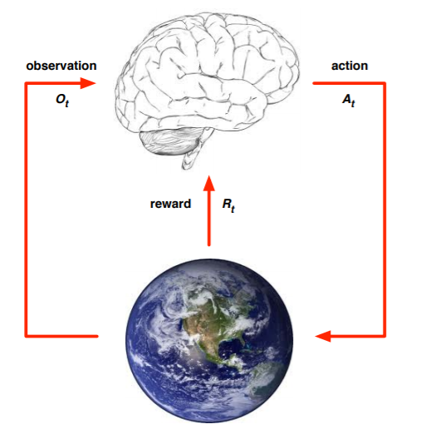

The Agent and the Environment
INTRODUCTION TO COMPUTING
Course Code: CCINCOM/L
At each timestep $t$, the agent:
• Performs an action $at$
• Receives observation $o_{t}$
• Receives reward $rt$
The environment:
• Receives action $at$
• Emits new observation $o_{t+1}$
• Emits reward for the agent $rt+1$
Joseph Marvin R. Imperial
REINFORCEMENT LEARNING
NU College of Computing and Information Technologies
Course Code: CCRNFLRL

Slide 4
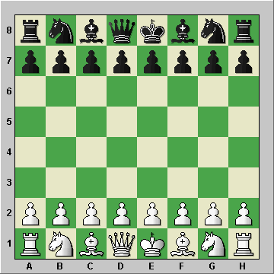

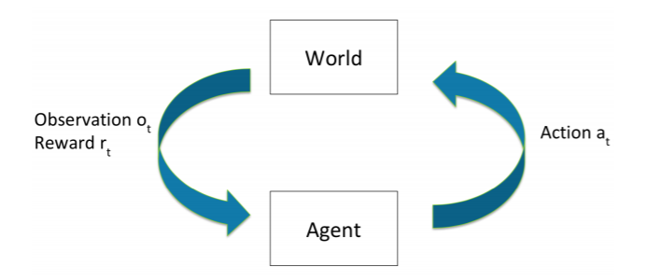

Fully Observable Environments
INTRODUCTION TO COMPUTING
Course Code: CCINCOM/L
Perfect information. The agent directly observes environment state.
Environment and world state $st = ot$
Formally, this is a Markov decision process (MDP).
Joseph Marvin R. Imperial
REINFORCEMENT LEARNING
NU College of Computing and Information Technologies
Course Code: CCRNFLRL

Slide 5
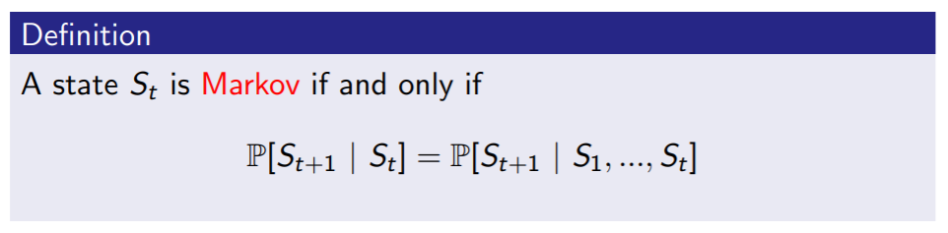
Markov Property
INTRODUCTION TO COMPUTING
Course Code: CCINCOM/L
“The future is independent of the past given the present.”
Once the state is known, the history may be thrown away because our current state already captures the information of the past states.
The (current) state is a sufficient statistic of the future.
Joseph Marvin R. Imperial
REINFORCEMENT LEARNING
NU College of Computing and Information Technologies
Course Code: CCRNFLRL

Slide 6
Markov Property
INTRODUCTION TO COMPUTING
Course Code: CCINCOM/L
0.7
0.3
0.5
Cloudy
Sunny
0.5
State Space = { Sunny, Cloudy}
Joseph Marvin R. Imperial
REINFORCEMENT LEARNING
NU College of Computing and Information Technologies
Course Code: CCRNFLRL

Slide 7

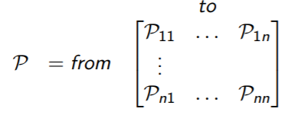
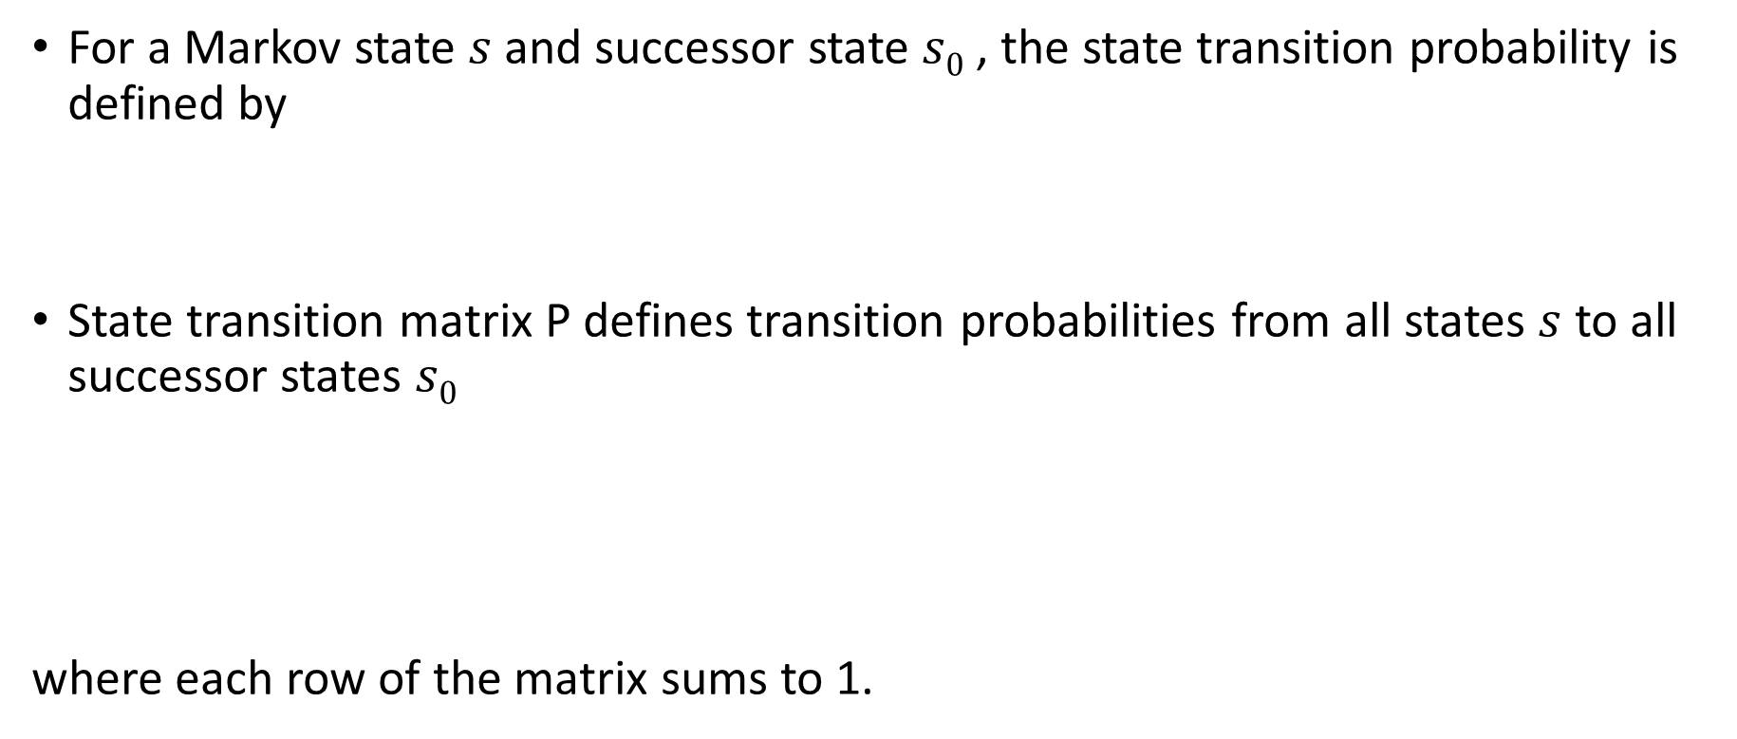
State Transition Matrix
INTRODUCTION TO COMPUTING
Course Code: CCINCOM/L
For a Markov state $s$ and successor state $s0$ , the state transition probability is defined by
State transition matrix P defines transition probabilities from all states $s$ to all successor states $s0$
where each row of the matrix sums to 1.
Joseph Marvin R. Imperial
REINFORCEMENT LEARNING
NU College of Computing and Information Technologies
Course Code: CCRNFLRL

Slide 8
Markov Decision Processes (MDPs)
INTRODUCTION TO COMPUTING
Course Code: CCINCOM/L
Markov decision processes formally describe an environment for reinforcement learning.
Where the environment is fully observable.
Almost all RL problems can be formalized as MDPs:
Optimal control primarily deals with continuous MDPs.
Partially observable problems can be converted into MDPs.
Bandits are MDPs with one state.
Joseph Marvin R. Imperial
REINFORCEMENT LEARNING
NU College of Computing and Information Technologies
Course Code: CCRNFLRL

Slide 9


Markov Property
INTRODUCTION TO COMPUTING
Course Code: CCINCOM/L
0.7
0.3
0.5
Cloudy
Sunny
0.5
$$s_{t+1}$$
 | 0.3 | 0.7
 | 0.5 | 0.5
$$s_{t}$$
State Space = { Sunny, Cloudy}
Transition Matrix
Joseph Marvin R. Imperial
REINFORCEMENT LEARNING
NU College of Computing and Information Technologies
Course Code: CCRNFLRL

Slide 10
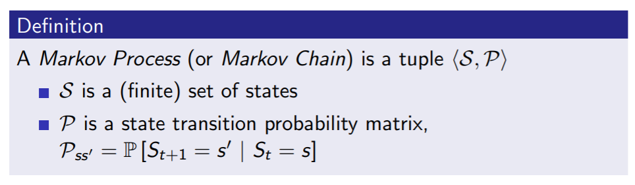

Markov Process
INTRODUCTION TO COMPUTING
Course Code: CCINCOM/L
A Markov process is a random process, i.e. a sequence of random states $S_{1},S_{2}$... with the Markov property.
Joseph Marvin R. Imperial
REINFORCEMENT LEARNING
NU College of Computing and Information Technologies
Course Code: CCRNFLRL

Slide 11
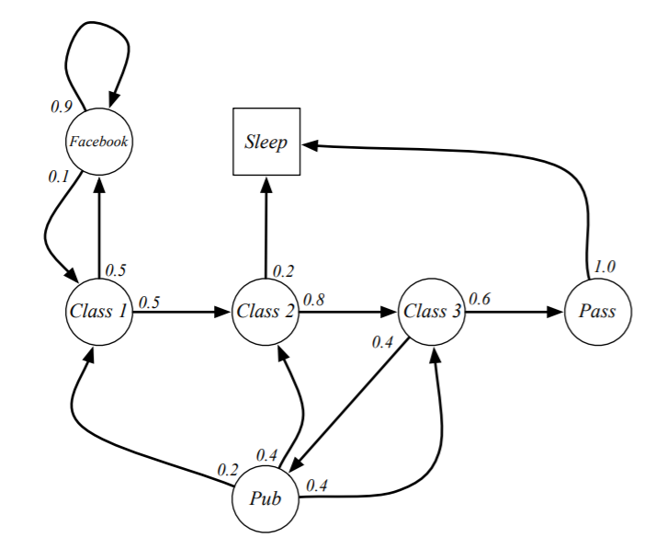
Student Markov Chain
INTRODUCTION TO COMPUTING
Course Code: CCINCOM/L
Joseph Marvin R. Imperial
REINFORCEMENT LEARNING
NU College of Computing and Information Technologies
Course Code: CCRNFLRL

Slide 12
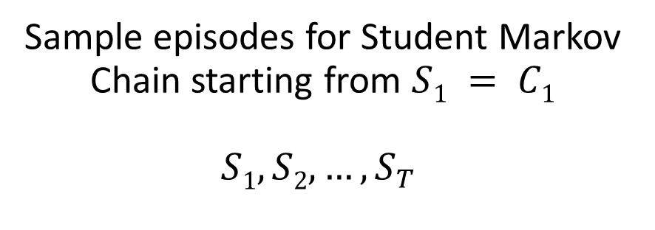
Student Markov Chain
INTRODUCTION TO COMPUTING
Course Code: CCINCOM/L
Sample episodes for Student Markov Chain starting from $S1 = C1$
$$S1, S2, …, S_{T}$$
C1 C2 C3 Pass Sleep
C1 FB FB C1 C2 Sleep
C1 C2 C3 Pub C2 C3 Pass Sleep
C1 FB FB C1 C2 C3 Pub C1 FB FB FB C1 C2 C3 Pub C2 Sleep
Joseph Marvin R. Imperial
REINFORCEMENT LEARNING
NU College of Computing and Information Technologies
Course Code: CCRNFLRL

Slide 13
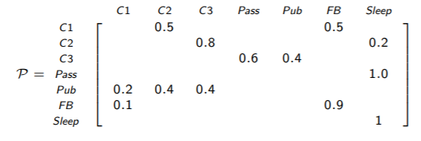
Student Markov Chain Transition Matrix
INTRODUCTION TO COMPUTING
Course Code: CCINCOM/L
Joseph Marvin R. Imperial
REINFORCEMENT LEARNING
NU College of Computing and Information Technologies
Course Code: CCRNFLRL

Slide 14
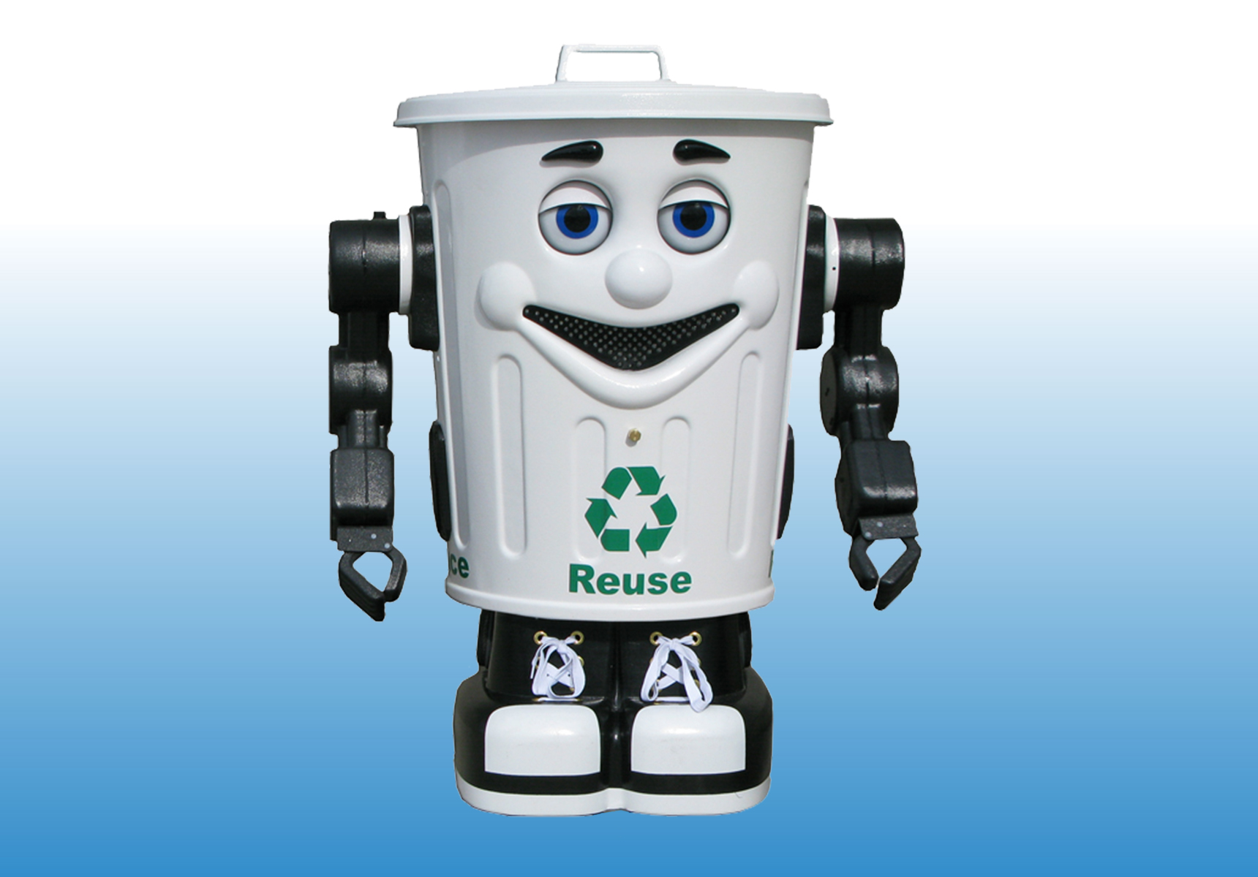
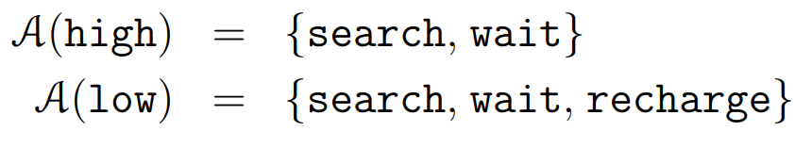

Recycling Robot Example
INTRODUCTION TO COMPUTING
Course Code: CCINCOM/L
Joseph Marvin R. Imperial
REINFORCEMENT LEARNING
NU College of Computing and Information Technologies
Course Code: CCRNFLRL

Slide 15
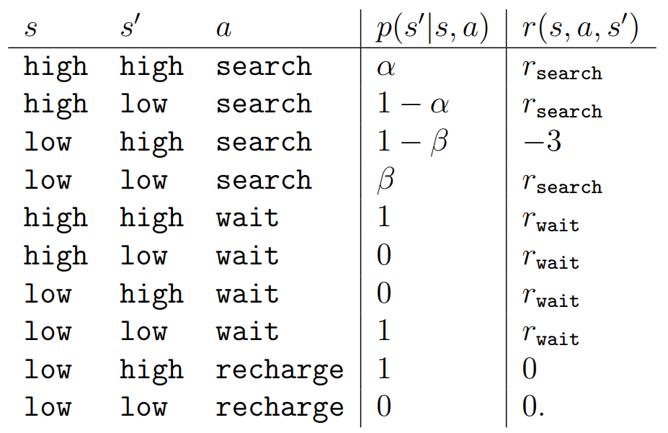
Recycling Robot Example
INTRODUCTION TO COMPUTING
Course Code: CCINCOM/L
Joseph Marvin R. Imperial
REINFORCEMENT LEARNING
NU College of Computing and Information Technologies
Course Code: CCRNFLRL

Slide 16
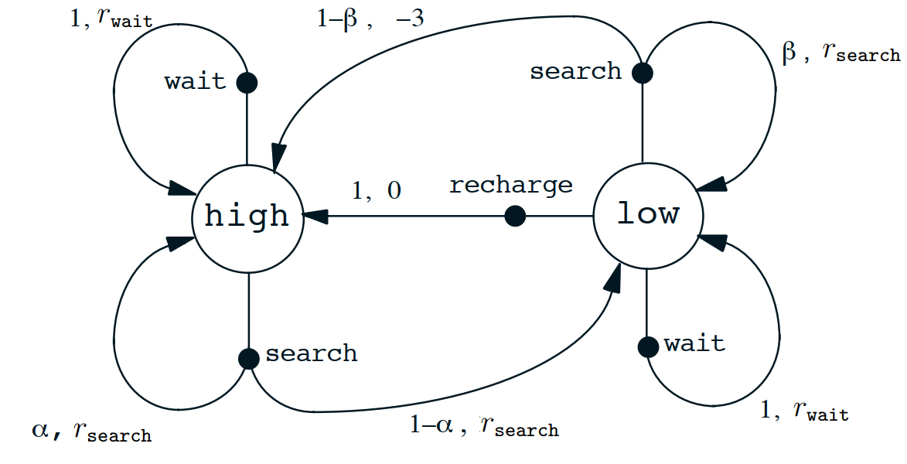
Recycling Robot Example
INTRODUCTION TO COMPUTING
Course Code: CCINCOM/L
Joseph Marvin R. Imperial
REINFORCEMENT LEARNING
NU College of Computing and Information Technologies
Course Code: CCRNFLRL

Slide 17
Outline
INTRODUCTION TO COMPUTING
Course Code: CCINCOM/L
Markov Processes
Markov Reward Processes
Markov Decision Processes
Joseph Marvin R. Imperial
REINFORCEMENT LEARNING
NU College of Computing and Information Technologies
Course Code: CCRNFLRL

Slide 18
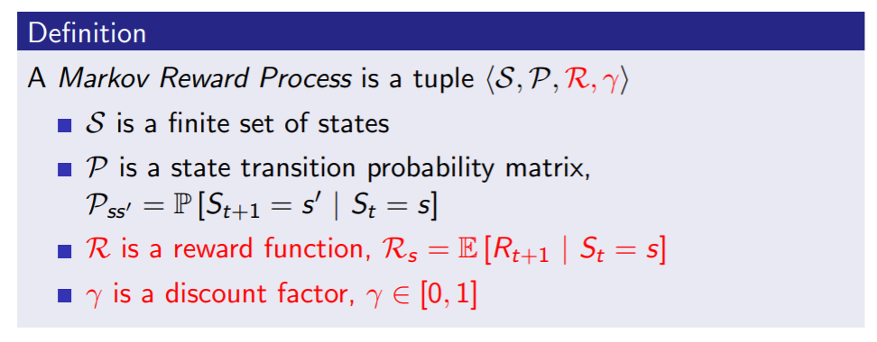
Markov Reward Process (MRPs)
INTRODUCTION TO COMPUTING
Course Code: CCINCOM/L
A Markov reward process is a Markov chain with values.
Joseph Marvin R. Imperial
REINFORCEMENT LEARNING
NU College of Computing and Information Technologies
Course Code: CCRNFLRL
Notes:
Reward function tells us that we start in any state S, if we are in some state how much reward do we get from that state only. This is just the immediate reward

Slide 19
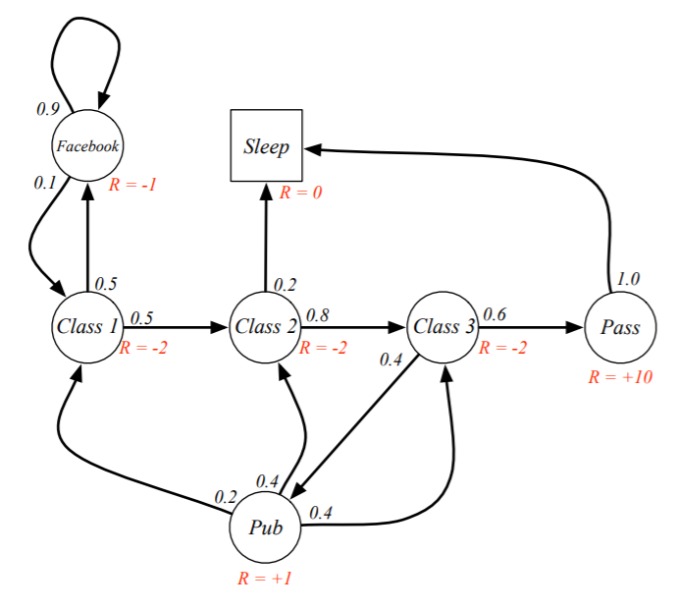
Markov Reward Process (MRPs)
INTRODUCTION TO COMPUTING
Course Code: CCINCOM/L
Joseph Marvin R. Imperial
REINFORCEMENT LEARNING
NU College of Computing and Information Technologies
Course Code: CCRNFLRL

Slide 20
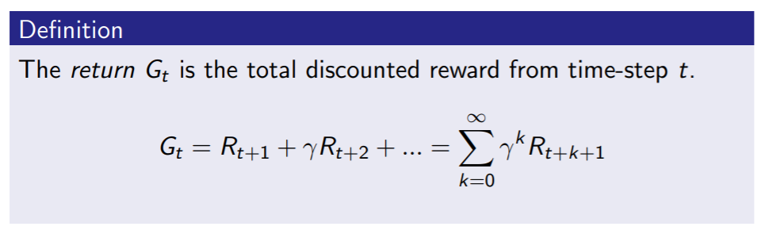

Return
INTRODUCTION TO COMPUTING
Course Code: CCINCOM/L
The discount $γ ∈ [0, 1]$is the present value of future rewards.
The value of receiving reward $R$ after $k + 1$time-steps is $γkR$.
This values immediate reward above delayed reward.
$γ$ close to 0 leads to ”myopic” evaluation.
$γ$ close to 1 leads to ”far-sighted” evaluation.
Review in Probability, Intro to RL Concepts
Joseph Marvin R. Imperial
REINFORCEMENT LEARNING
NU College of Computing and Information Technologies
Course Code: CCRNFLRL
Notes:
G (goal) of reinforcement learning is to maximize the return.
The discount factor makes the return finite.
We are going to discount by a factor of gamma at each time step into the future.
The discount factor has to be between zero and one.
If the discount factor is close to zero. Then you only care about the immediate reward
If the discount factor is close to one. Then you care about future rewards.

Slide 21
Why discount the reward?
INTRODUCTION TO COMPUTING
Course Code: CCINCOM/L
Uncertainty about the future may not be fully represented.
Animal/human behavior shows preference for immediate reward.
Joseph Marvin R. Imperial
REINFORCEMENT LEARNING
NU College of Computing and Information Technologies
Course Code: CCRNFLRL

Slide 22
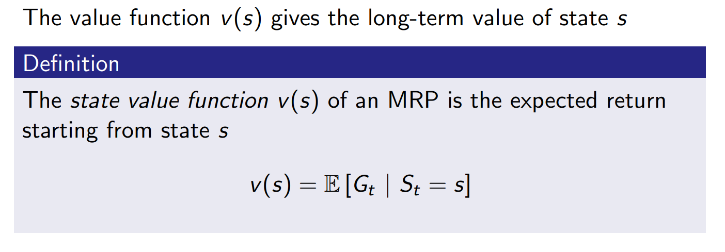
Value Function
INTRODUCTION TO COMPUTING
Course Code: CCINCOM/L
Joseph Marvin R. Imperial
REINFORCEMENT LEARNING
NU College of Computing and Information Technologies
Course Code: CCRNFLRL
Notes:
If you are in state S, how much value will you get from there on.
What is the total reward you will get from that state there on.
Basically what this says is that if i drop you on to this MRP on some state for example class 2, how much reward will you get until you terminate?
We prefer states that gives us more total rewards.

Slide 23
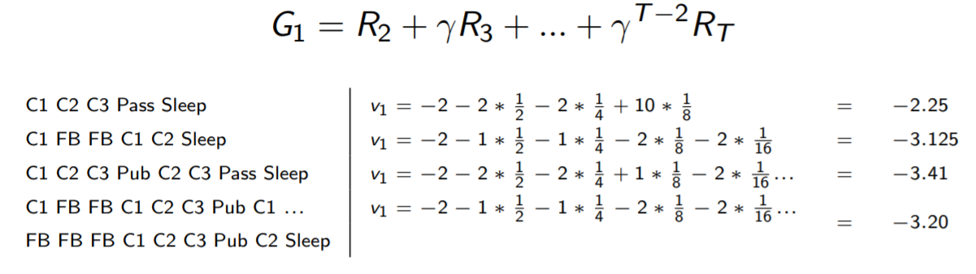

Example: Student Markov Chain Returns
INTRODUCTION TO COMPUTING
Course Code: CCINCOM/L
Sample returns for Student Markov Chain:
Starting from $S1 = C1$with $γ = ½$
Joseph Marvin R. Imperial
REINFORCEMENT LEARNING
NU College of Computing and Information Technologies
Course Code: CCRNFLRL

Slide 24
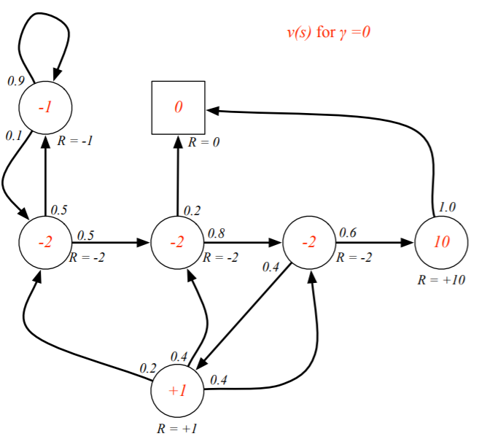
State-Value Function for Student MRP
INTRODUCTION TO COMPUTING
Course Code: CCINCOM/L
Joseph Marvin R. Imperial
REINFORCEMENT LEARNING
NU College of Computing and Information Technologies
Course Code: CCRNFLRL

Slide 25
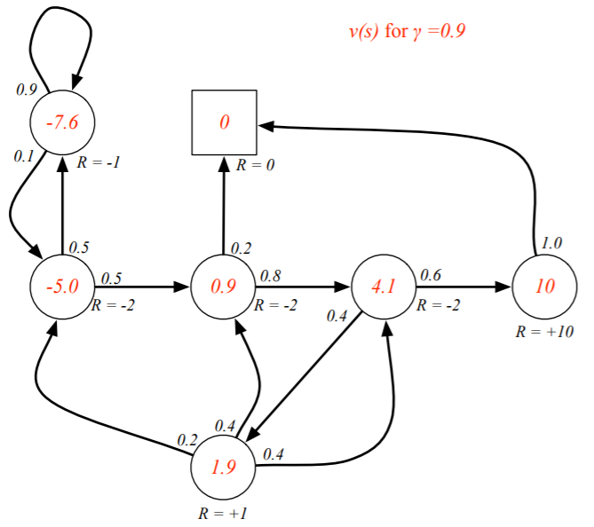
State-Value Function for Student MRP
INTRODUCTION TO COMPUTING
Course Code: CCINCOM/L
Joseph Marvin R. Imperial
REINFORCEMENT LEARNING
NU College of Computing and Information Technologies
Course Code: CCRNFLRL

Slide 26
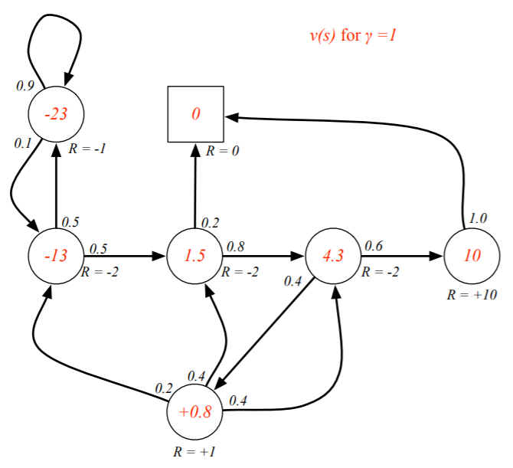
State-Value Function for Student MRP
INTRODUCTION TO COMPUTING
Course Code: CCINCOM/L
Joseph Marvin R. Imperial
REINFORCEMENT LEARNING
NU College of Computing and Information Technologies
Course Code: CCRNFLRL

Slide 27
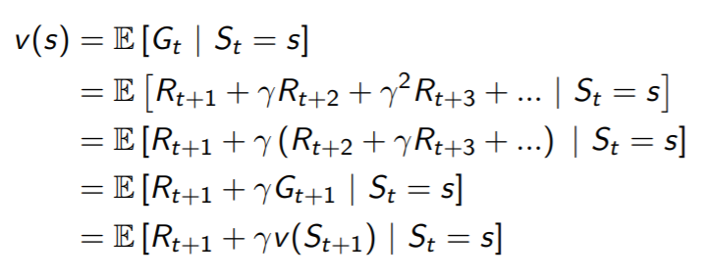

Bellman Equation for MRPs
INTRODUCTION TO COMPUTING
Course Code: CCINCOM/L
The value function can be decomposed into two parts:
immediate reward $R_{t+1}$
discounted value of successor state $γv(S_{t+1})$
Joseph Marvin R. Imperial
REINFORCEMENT LEARNING
NU College of Computing and Information Technologies
Course Code: CCRNFLRL

Slide 28
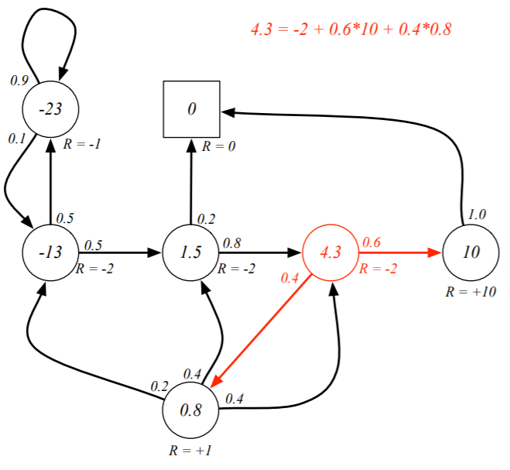
Bellman Equation for Student MRP
INTRODUCTION TO COMPUTING
Course Code: CCINCOM/L
Joseph Marvin R. Imperial
REINFORCEMENT LEARNING
NU College of Computing and Information Technologies
Course Code: CCRNFLRL

Slide 29
Outline
INTRODUCTION TO COMPUTING
Course Code: CCINCOM/L
Markov Processes
Markov Reward Processes
Markov Decision Processes
Joseph Marvin R. Imperial
REINFORCEMENT LEARNING
NU College of Computing and Information Technologies
Course Code: CCRNFLRL

Slide 30
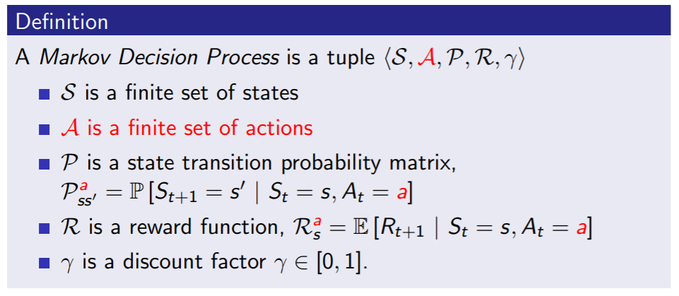
Markov Decision Processes (MDPs)
INTRODUCTION TO COMPUTING
Course Code: CCINCOM/L
A Markov decision process (MDP) is a Markov reward process with decisions. It is an environment in which all states are Markov.
Joseph Marvin R. Imperial
REINFORCEMENT LEARNING
NU College of Computing and Information Technologies
Course Code: CCRNFLRL

Slide 31
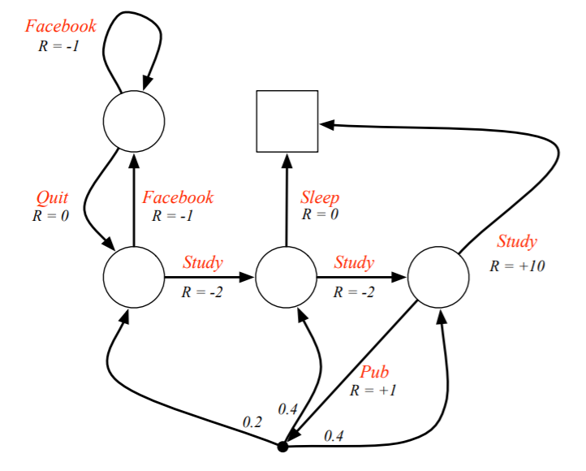
Student MDP
INTRODUCTION TO COMPUTING
Course Code: CCINCOM/L
Joseph Marvin R. Imperial
REINFORCEMENT LEARNING
NU College of Computing and Information Technologies
Course Code: CCRNFLRL

Slide 32
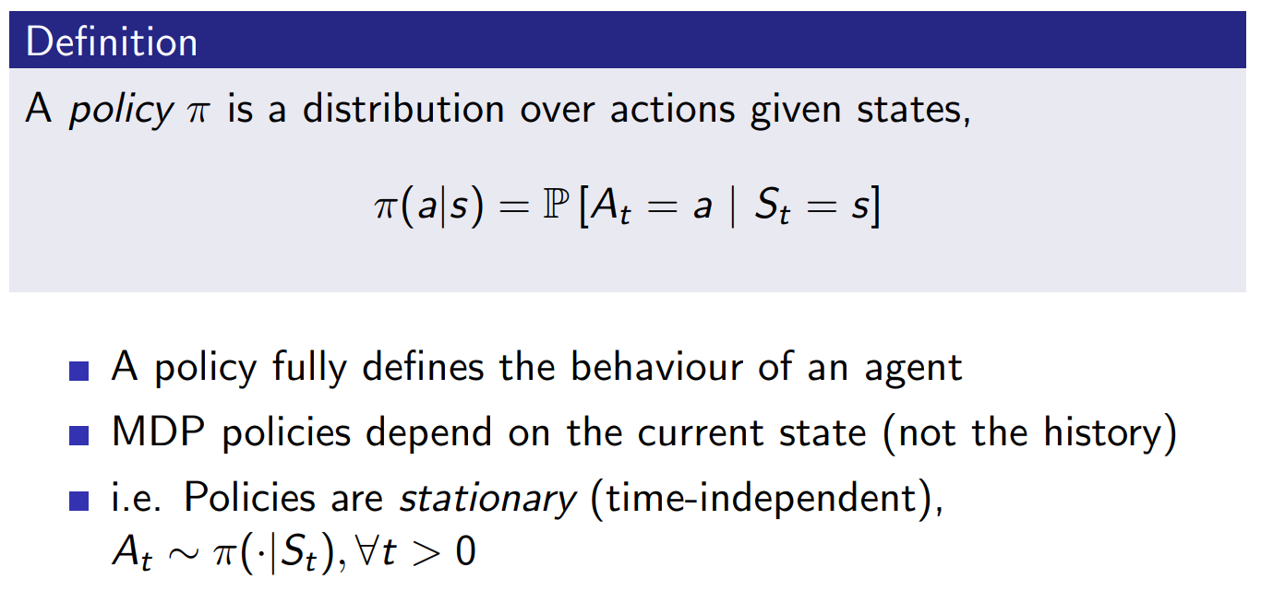
Policies
INTRODUCTION TO COMPUTING
Course Code: CCINCOM/L
Joseph Marvin R. Imperial
REINFORCEMENT LEARNING
NU College of Computing and Information Technologies
Course Code: CCRNFLRL

Slide 33
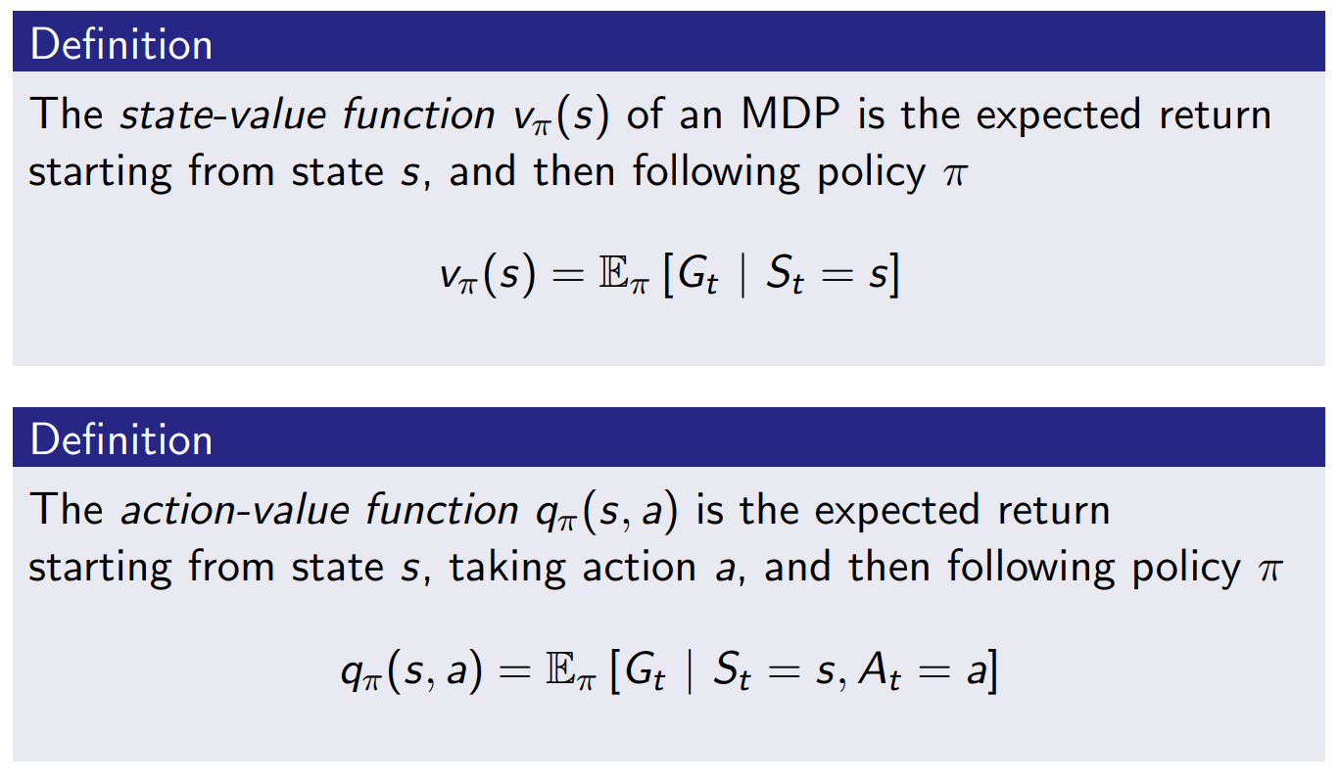
Value Function
INTRODUCTION TO COMPUTING
Course Code: CCINCOM/L
Joseph Marvin R. Imperial
REINFORCEMENT LEARNING
NU College of Computing and Information Technologies
Course Code: CCRNFLRL

Slide 34
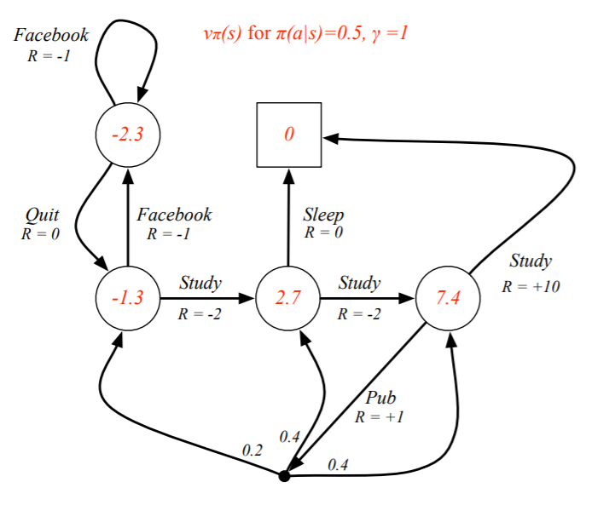
Student Value-Function MDP
INTRODUCTION TO COMPUTING
Course Code: CCINCOM/L
Joseph Marvin R. Imperial
REINFORCEMENT LEARNING
NU College of Computing and Information Technologies
Course Code: CCRNFLRL

Slide 35
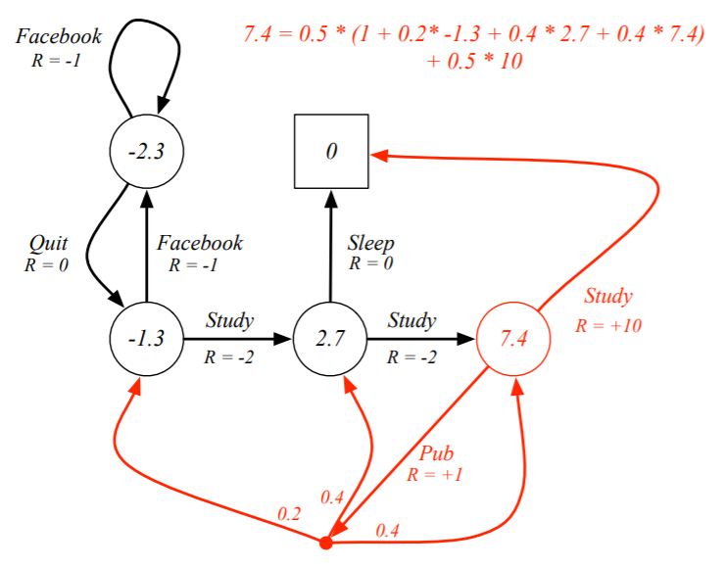
Bellman Expectation Equation in Student MDP
INTRODUCTION TO COMPUTING
Course Code: CCINCOM/L
Joseph Marvin R. Imperial
REINFORCEMENT LEARNING
NU College of Computing and Information Technologies
Course Code: CCRNFLRL

Slide 36
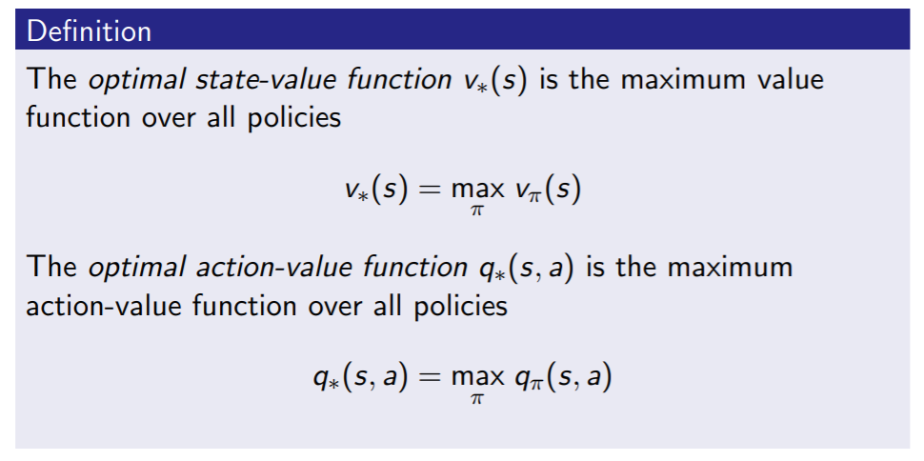
Optimal Value Function
INTRODUCTION TO COMPUTING
Course Code: CCINCOM/L
The optimal value function specifies the best possible performance in the MDP.
An MDP is “solved” when we know the optimal value.
Joseph Marvin R. Imperial
REINFORCEMENT LEARNING
NU College of Computing and Information Technologies
Course Code: CCRNFLRL

Slide 37
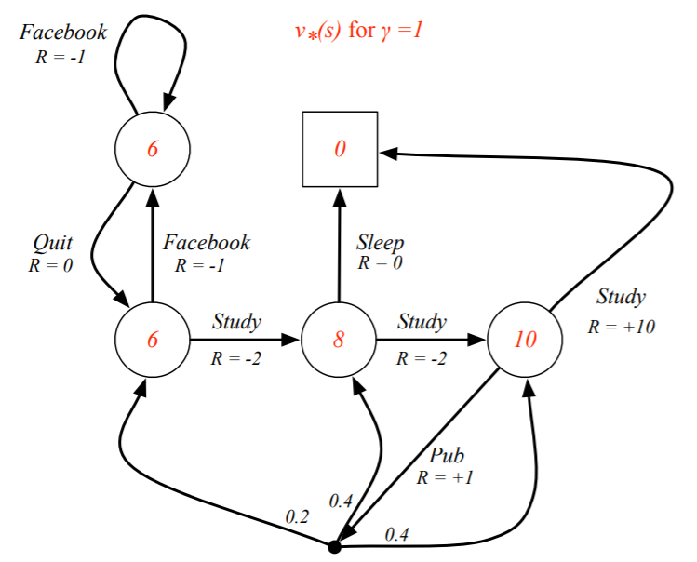
Optimal Value Function for Student MDP
INTRODUCTION TO COMPUTING
Course Code: CCINCOM/L
Joseph Marvin R. Imperial
REINFORCEMENT LEARNING
NU College of Computing and Information Technologies
Course Code: CCRNFLRL

Slide 38
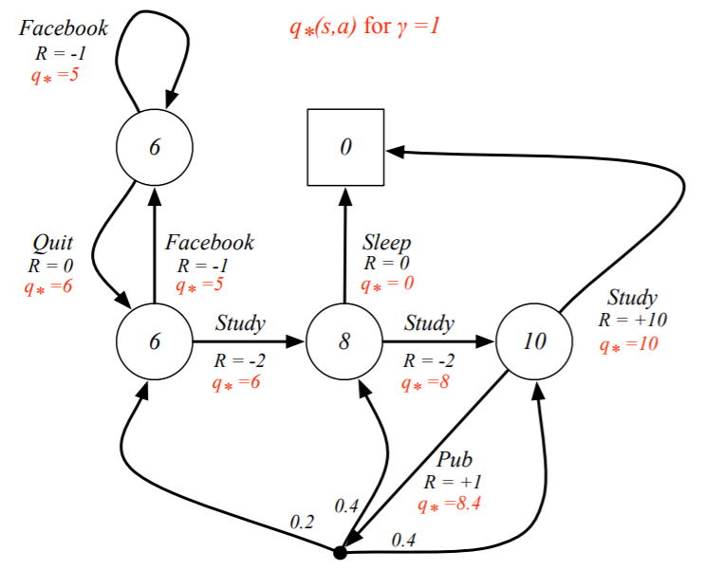
Optimal Action-Value Function for Student MDP
INTRODUCTION TO COMPUTING
Course Code: CCINCOM/L
Joseph Marvin R. Imperial
REINFORCEMENT LEARNING
NU College of Computing and Information Technologies
Course Code: CCRNFLRL

Slide 39
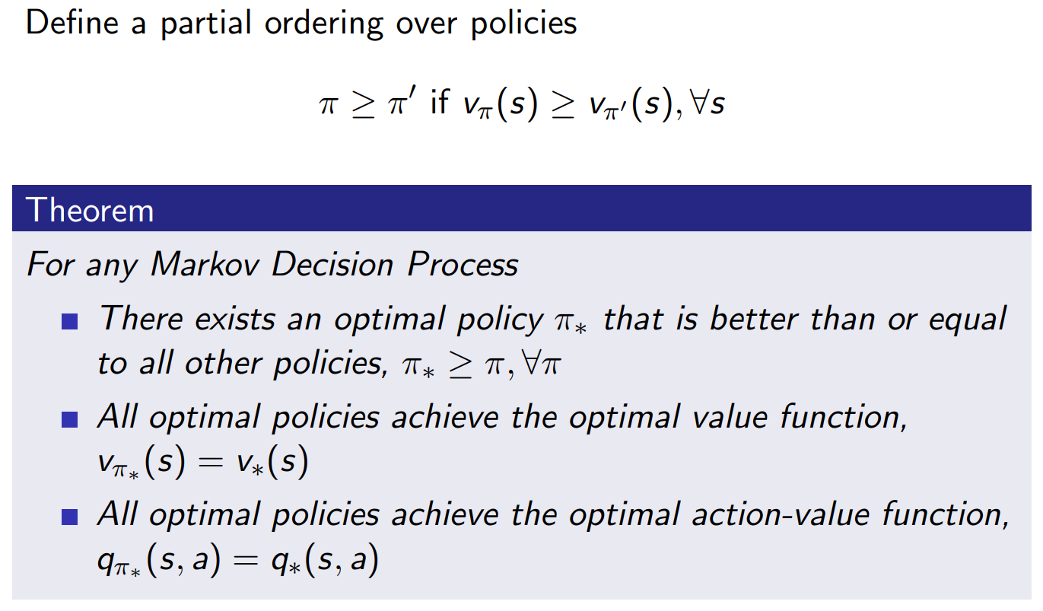
Optimal Policy
INTRODUCTION TO COMPUTING
Course Code: CCINCOM/L
Joseph Marvin R. Imperial
REINFORCEMENT LEARNING
NU College of Computing and Information Technologies
Course Code: CCRNFLRL

Slide 40
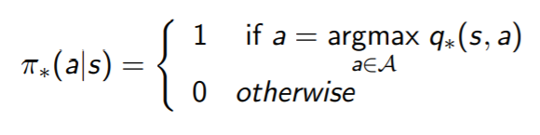
Finding an Optimal Policy
INTRODUCTION TO COMPUTING
Course Code: CCINCOM/L
An optimal policy can be found by maximizing over q∗(s, a)
There is always a deterministic optimal policy for any MDP.
If we know q∗(s, a), we immediately have the optimal policy.
Joseph Marvin R. Imperial
REINFORCEMENT LEARNING
NU College of Computing and Information Technologies
Course Code: CCRNFLRL

Slide 41
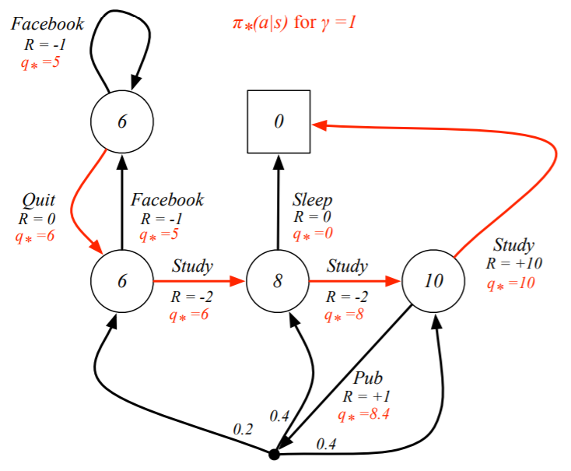
Optimal Policy for Student MDP
INTRODUCTION TO COMPUTING
Course Code: CCINCOM/L
Joseph Marvin R. Imperial
REINFORCEMENT LEARNING
NU College of Computing and Information Technologies
Course Code: CCRNFLRL

Slide 42
References
INTRODUCTION TO COMPUTING
Course Code: CCINCOM/L
Images are licensed with Creative Commons. Can use without citing.
Prof. Emma Brunskill’s slides (CS234RL). https://web.stanford.edu/class/cs234/slides/lecture1.pdf
David Silver’s slides. https://www.davidsilver.uk/wp-content/uploads/2020/03/intro_RL.pdf
Review in Probability, Intro to RL Concepts
Joseph Marvin R. Imperial
REINFORCEMENT LEARNING
NU College of Computing and Information Technologies
Course Code: CCRNFLRL

